Slide 1
MAK NGAH CATERING FOOD ORDERING SYSTEM
KHAIRUL IDZHAM – B17CS3006
WAN NUR KHALISHAH – B17CS3033
FATIN AMIRAH SYAZANA – B17CS0007
MASTURINA HAFIZAH – B1CS0012

Slide 2
PROBLEM STATEMENT
Ordering foods in average restaurants in Malaysia is mostly done through a waiter. The customers will verbally tell waiter what they want to order, and it will then be written down on a piece of paper or just by memorizing it, then they bring the orders to the kitchen. A number of problems can be caused by using this method such as some orders will not even reach the kitchen due to a lot of customers and time constraint. Other than that, many of the restaurants store their menu in a form of printed books. The problem is that the prices of foods flunctuate so often that most of the time the displayed price on the menu is not accurate.

Slide 3
OBJECTIVE
To develop a system that will surely satisfied the customer service.
To design a system able to accommodate huge amount of orders at a time.
To enable customers to have a visual confirmation that the order was placed correctly.
To improve the communication between the client and the server and minimize the time of ordering.

Slide 4
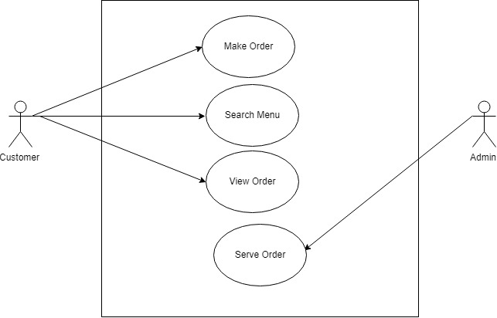
USE CASE DIAGRAM
Remove Order

Slide 5
USE CASE DESCRIPTION
Actor | Task
Admin | Receives the order placed by the customer through internal order system.
Customer | Customer places an order from the available choices after indicating his preference for the session.

Slide 6
USE CASE DESCRIPTION
Make Order
Customer should be able to make an order from the available choices
Customer should be able to view the list of menu that Mak Ngah Catering provided
Customer should be able to insert the food quantity
The system should be able to provide customer with the queue number
The system should be able to calculate the total price
Remove Order
The system should be able make admin to served order to the customer in queue
Instant Order
Customer and admin should be able to view instant order preview
Customer should be able to view their queue number in a list
Search Menu
The system should be able customer to search what kind of food Mak Ngah provided

Slide 7
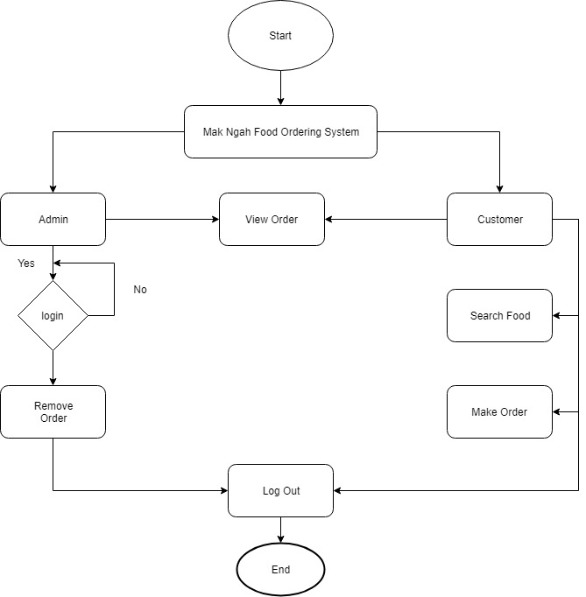
FLOWCHART

Slide 8
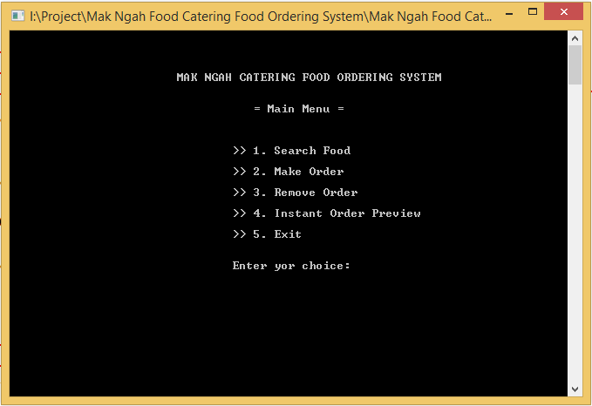
INTERFACE

Slide 9
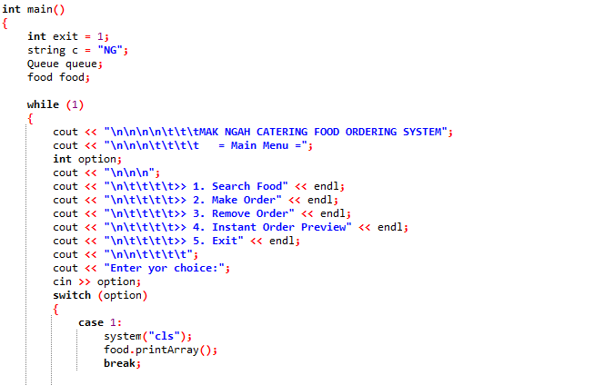
MAIN OPERATION

Slide 10
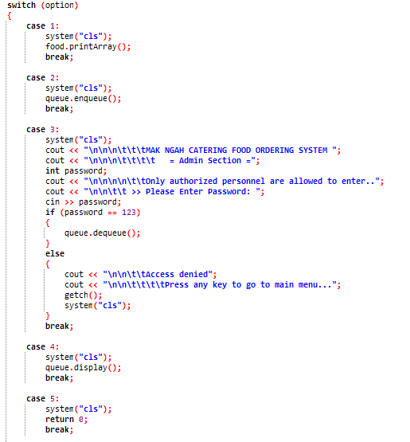
MAIN OPERATION
Search Food
Make Order
Remove Order
(Admin)
Instant Order Preview
Exit

Slide 11
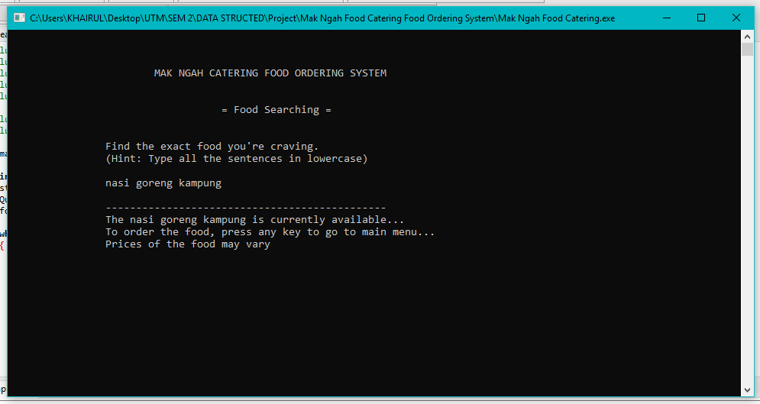
INTERFACE
Searching Interface

Slide 12
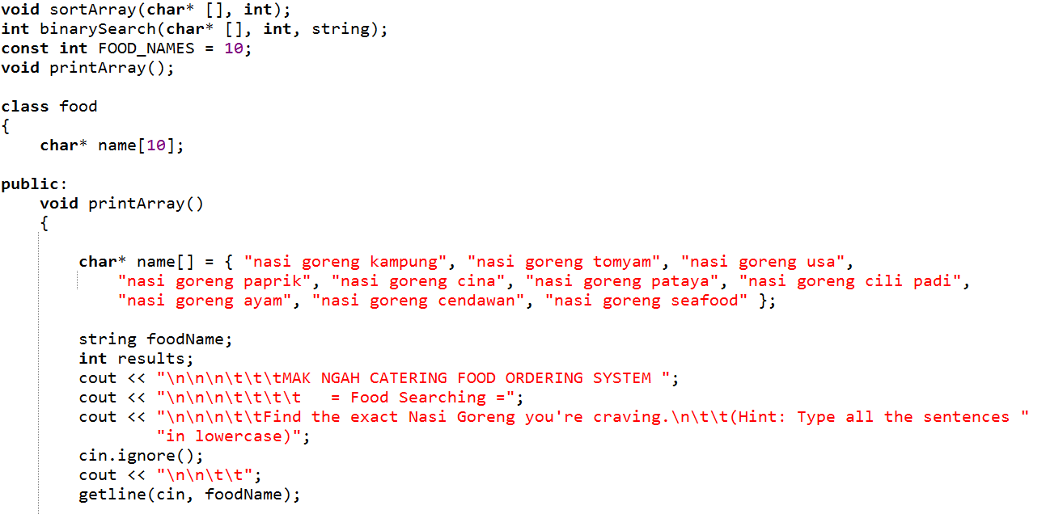
SORTING CODE
Sorting time and the number of comparisons
Unsorted List

Slide 13
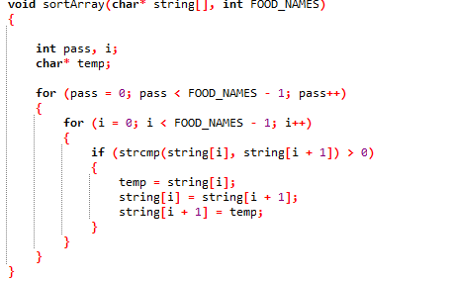
SORTING CODE
Bubble Sort
Control the number of
passes needed
Compare adjacent element and swap element if they are not in order

Slide 14
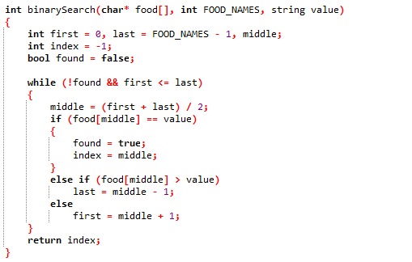
SEARCHING CODE
Binary Search
Get Middle index
Search is focused on the left and right side of list

Slide 15
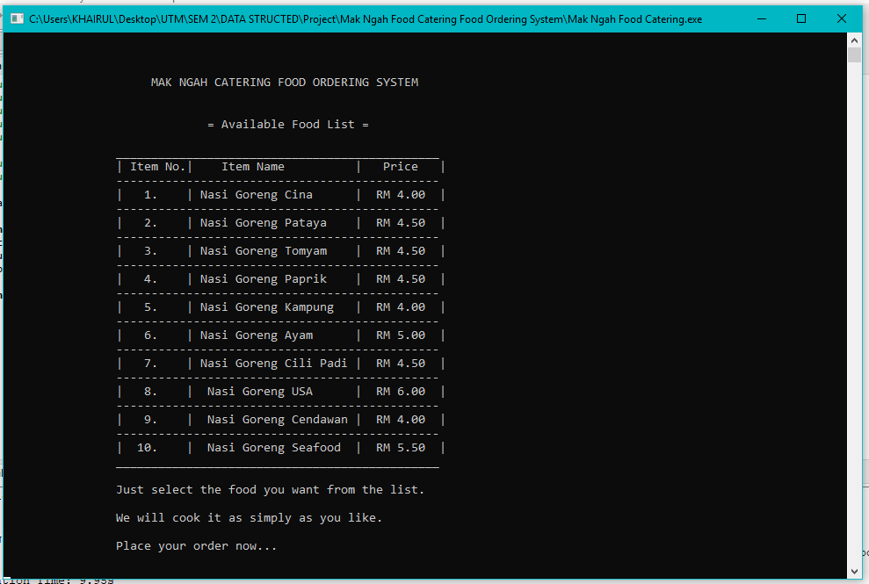
INTERFACE
Make Order Interface

Slide 16
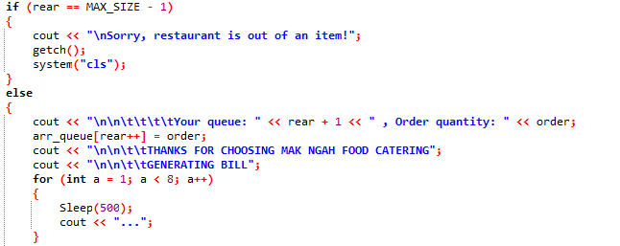
QUEUE OPERATION
Check whether a queue is FULL
Queue is FULL
Retrieve Item
At front

Slide 17
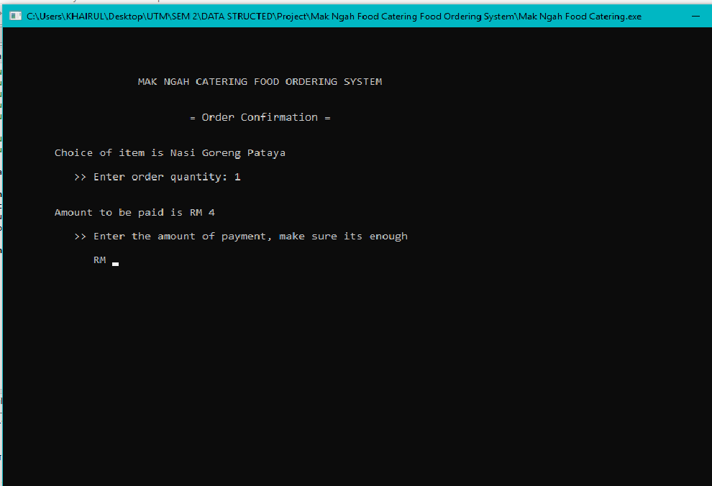
INTERFACE
Make Order Interface

Slide 18
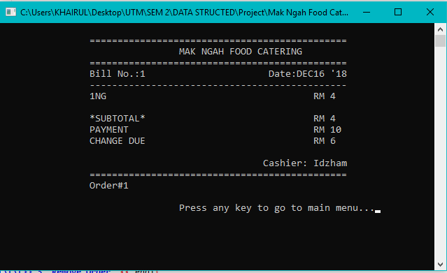
INTERFACE
Make Order Interface

Slide 19
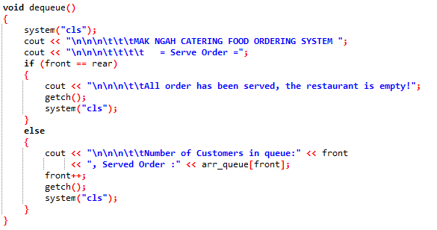
DEQUEUE OPEARTION
Retrieve Item at front

Slide 20
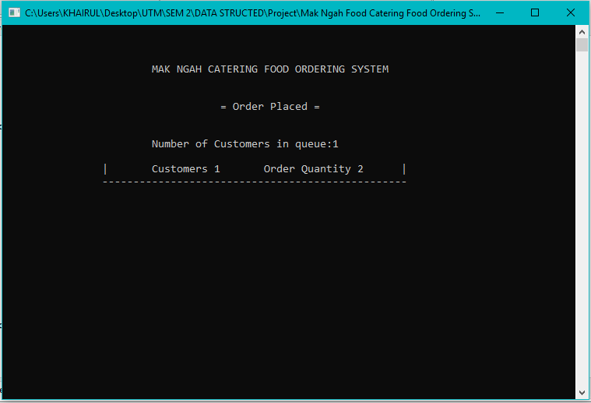
INTERFACE
Instant Order Preview

Slide 21
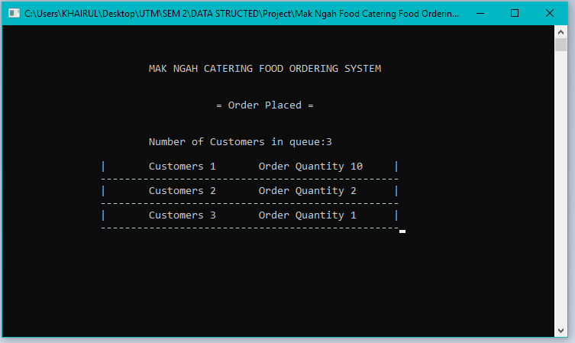
INTERFACE
Instant Order Preview

Slide 22
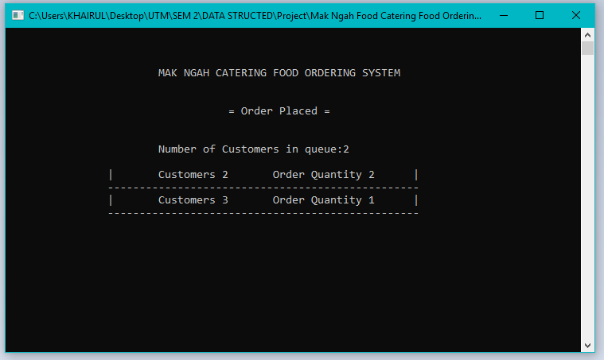
INTERFACE
Instant Order Preview

Slide 23
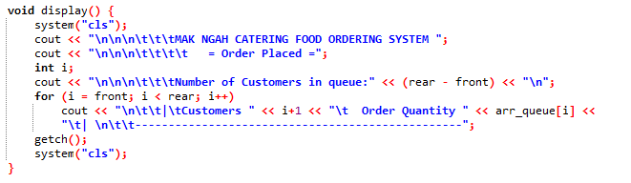
DISPLAY OPERATION

